Slide 1
Supply of Money and it Determinants
Money supply plays a crucial role in the determination of price level and interest rate.
The determination of money supply, besides Central Bank and Government, the public and commercial banks also play an important role.
Growth of money supply is an important factor not only for acceleration of the process of economic development but also for the achievement of price stability in the economy.
The money supply refers to the total sum of money available to the public in the economy at a point of time

Slide 2
THE CONCEPT OF MONEY SUPPLY AND ITS MEASUREMENT
According to the standard concept of money supply, it is composed of the following two elements :
Currency with the public
Demand deposits with the public
1.Currency with the Public
In order to arrive at the total currency with the public in Pakistan we add the following items:
Currency notes in circulation issued by the State Bank of Pakistan.
Small coins in circulation

Slide 3
Continue…
Demand Deposits with the Public
These demand deposits held by the public are also called bank money or deposit money.
Deposits with the banks are broadly divided into two types: demand deposits and time deposits.
Demand deposits in the banks are those deposits which can be withdrawn by drawing cheques on them

Slide 4
FOUR MEASURES OF MONEY SUPPLY
The main reason why money supply is classified into various measures on the basis of its functions is that effective predictions can be made about the likely effects on the economy of changes in the different components of money supply.
Money Supply M1 or Narrow Money.
This is the narrow measure of money supply and is composed of the following items:
M1 = C + DD + OD
where
C = Currency with the public
DD = Demand deposits with the public in the commercial and cooperative banks.
OD = Other deposits held by the public with State Bank.

Slide 5
Continue…
2. Money Supply M2 includes savings deposits with the post office savings banks.
M 2 = M1 + Savings deposits with the post office savings banks
3. Money Supply M 3 or Broad Money
In addition to the items of money supply included in measure M2, in money supply M3 time deposits with the banks are also included.
Thus M3 = M2+ Time Deposits with the banks.
This M3 is called Aggregate Monetary Resources (AMR).
4. Money Supply M4
M4 = M3 + Total Deposits with Post Office Savings Organisation

Slide 6
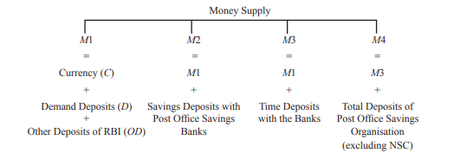
Summary

Slide 7
DETERMINANTS OF MONEY SUPPLY : MONEY MULTIPLIER THEORY
We shall denote it simply by M rather than M1.
The concept of money supply is composed of currency held by the public (Cp ) and demand deposits with the banks (D). Thus
M = Cp + D ...(1)
where M = Total money supply with the public Cp = Currency with the public D = Demand deposits held by the public.
The two important determinants of money supply as described in equation (1) are
the amounts of high-powered money which is also called Reserve Money by the Reserve Bank of India and
the size of money multiplier

Slide 8
Continue…
High-Powered Money (H)
The high-powered money which we denote by H consists of the currency (notes and coins) issued by the Government and the State Bank.
H = Cp + R ...(2)
where H = the amount of high-powered money Cp = Currency held by the public R = Cash Reserves of currency with the banks.
It is worth noting that State Bank and Government are producers of the high-powered money and the commercial banks do not have any role in producing this high-powered money (H)

Slide 9
Continue…
2. Money Multiplier. money multiplier is the degree to which money supply is expanded as a result of the increase in high-powered money. Thus = m= M/H
Rearranging we have, M = H.m
Thus money supply is determined by the size of money multiplier (m) and the amount of high-powered money (H).
Size of Money Multiplier
we know that total money supply (M) consists of currency with the public (Cp ) and demand deposits with the banks.
Thus M = Cp + D . . . (1)

Slide 10
Continue…
The public hold the amount of currency in a certain ratio of demand deposits with the banks. Let this currency-deposit ratio be denoted by k
Cp = kD
Substituting kD for Cp in equation (1) we have
M = kD + D = (k + 1)D (2)
Now take equation which defines high powered money (H) as
H = Cp + R (3)
where R represents cash or currency reserves which banks keep as a certain ratio of their deposits and is called cash-reserve ratio and is denoted by r. Thus
R = rD
Now substituting rD for R and kD for Cp in equation (3) we have
H = kD + rD
H = (k + r) D (4)

Slide 11
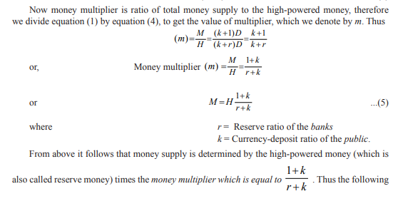

Slide 12
Continue….
factors determine money supply in the economy:
H, that is, the amount of high-powered money.
2. r, that is, cash reserve ratio of banks (i.e., ratio of currency reserves to deposits in the banks). This cash reserve ratio of banks determines the magnitude of money multiplier. The smaller the cash reserve ratio of the banks, the larger is the money multiplier.
3. k, that is, currency-deposit ratio of the public. The smaller the currency-deposit ratio of the public, the larger is the size of money multiplier.
From equation (4) expressing the determinants of money supply, it follows that money supply will increase :
When the supply of high-powered money (i.e., reserve money) H increases;
When the currency-deposit ratio (k) of the public decreases3 ; and
When the currency reserves-deposit ratio (i.e., cash reserve ratio) of the banks (r) falls

Slide 13
Inflation
Symbolically, Fisher’s equation of exchange is written as under :
MV = PT ...(1)
where M = the quantity of money in circulation
V = transactions velocity of circulation
P = Average price
T = the total number of transactions.
The above equation (1) is an identity, that is true by definition. However by taking some assumptions about the variables V and T, Fisher transformed the above identity into a theory of demand for money.

